Slide 1
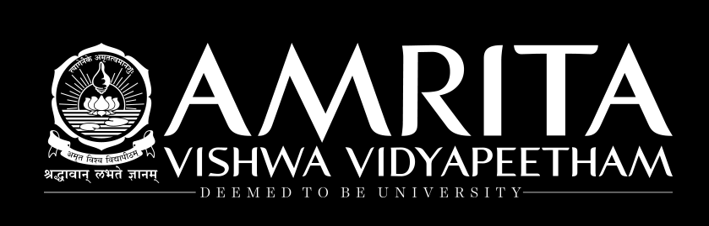
Support Vector Machine (SVM)

Slide 2
SUPPORT VECTOR MACHINES
Most popular Supervised Learning algorithms, which is used for Classification as well as Regression problems.
Primarily, it is used for Classification problems in Machine Learning.
Support vector machine is highly preferred by many as it produces significant accuracy with less computation power
There is really no specialized hardware.
But it is a powerful algorithm that has been quite successful in applications ranging from pattern recognition to text mining.

Slide 3
SVM emphasizes the interdisciplinary nature of data science by drawing equally from three major areas:
computer science,
statistics, and
Mathematical optimization theory.

Slide 4
Characteristics
At a basic level, a SVM is a classification method.
The goal of the SVM algorithm is to create the best line or decision boundary that can segregate n-dimensional space into classes so that we can easily put the new data point in the correct category in the future.
This best decision boundary is called a hyperplane
In a simple example of two dimensions, this boundary can be a straight line or a curve.
The advantage of a SVM is that once a boundary is established, most of the training data is redundant.

Slide 5
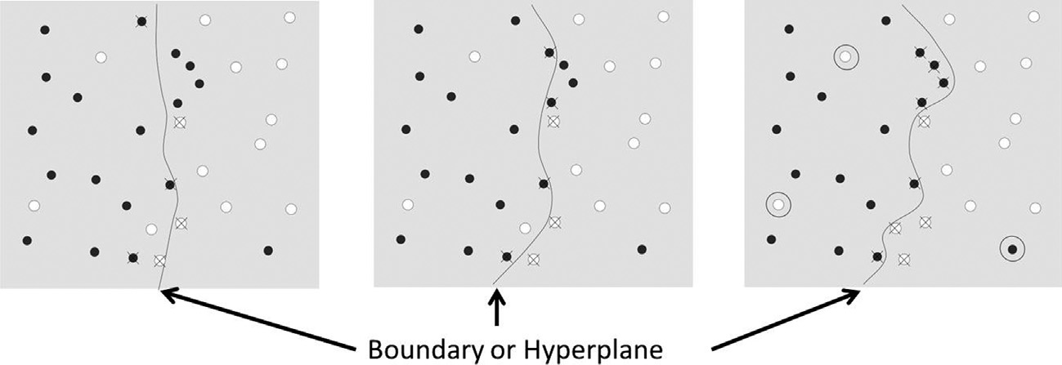
Decision Boundary

Slide 6
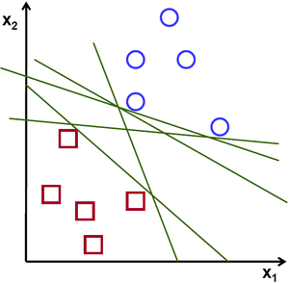
Possible hyperplanes

Slide 7
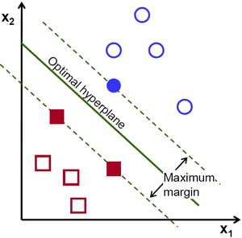
Important Terminologies in SVM
Support Vectors
Datapoints that are closest to the hyperplane is called support vectors.
Separating line will be defined with the help of these data points.
Hyperplane
As we can see in the diagram, it is a decision plane or space which is divided between a set of objects having different classes.

Slide 8
Margin
It may be defined as the gap between two lines on the closet data points of different classes.
It can be calculated as the perpendicular distance from the line to the support vectors.
Large margin is considered as a good margin and small margin is considered as a bad margin.
The hyperplane with maximum margin is called the optimal hyperplane

Slide 9
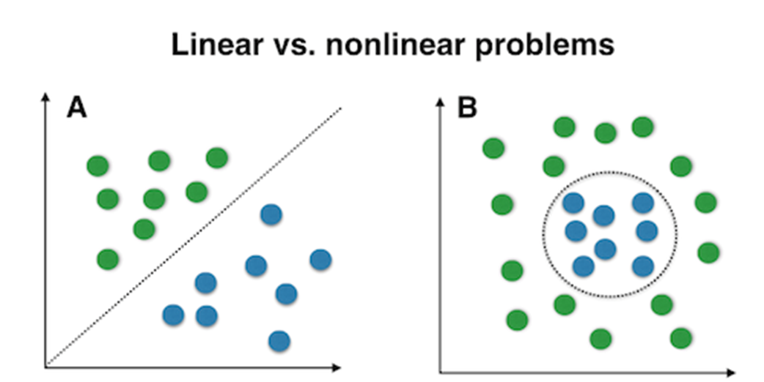
Linear separability:
A dataset is linearly separable if there is at least one line that clearly distinguishes the classes.
Non-linear separability:
A dataset is said to be non-linearly separable if there isn’t a single line that clearly distinguishes the classes.

Slide 10
Goal
The main goal of SVM is to divide the datasets into classes to find a Maximum Marginal Hyperplane (MMH).
It can be done in the following two steps −
First, SVM will generate hyperplanes iteratively that segregates the classes in best way.
Then, it will choose the hyperplane that separates the classes correctly.

Slide 11
All it needs is a core set of points that can help identify and fix the boundary.
These data points are called support vectors because they “support” the boundary.
A Support Vector Machine (SVM) can be imagined as a surface that creates a boundary between points of data plotted in multidimensional that represent examples and their feature values

Slide 12
What is Support Vector Machine?
The objective of the support vector machine algorithm is to find a hyperplane in an N-dimensional space(N — the number of features) that distinctly classifies the data points.

Slide 13
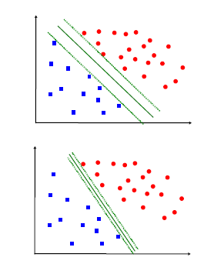
Selection of a Good Hyper-Plane
Objective:
Select a `good' hyper-plane using only the data
Intuition: assuming linear separability
(i) Separate the data
(ii) Place hyper-plane `far' from data

Slide 14
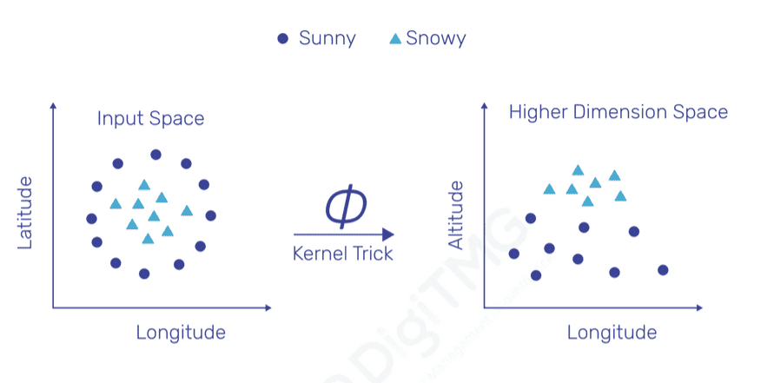
KERNEL TRICK

Slide 15
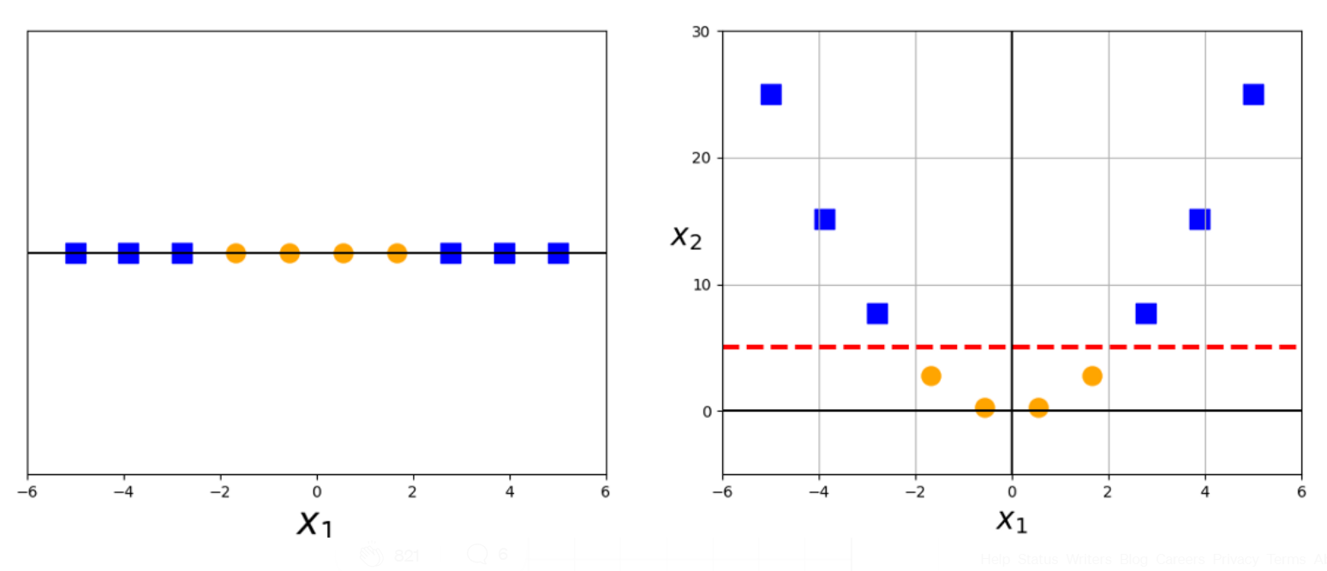
Kernel Trick

Slide 16
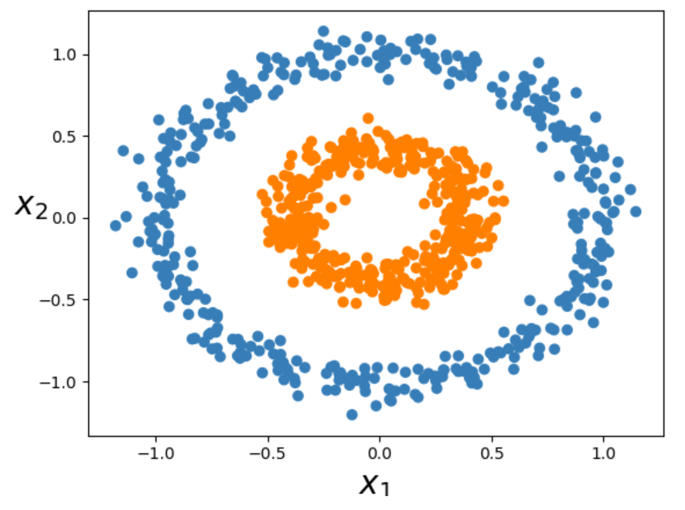

Slide 17
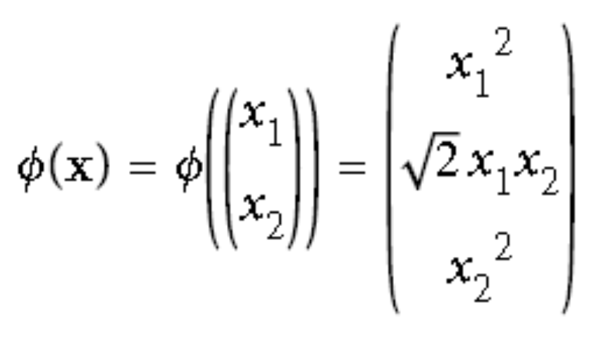
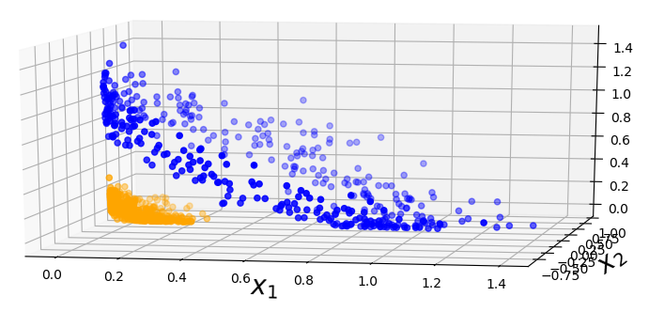
After the transformation,
The data becomes linearly separable (by a 2-d plane) in 3-dimensions

Slide 18
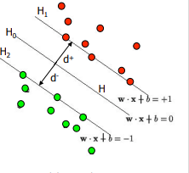

Definitions
Define the hyperplane H such that:
x_{i}•w+b = +1 when y_{i} =+1
x_{i}•w+b = -1 when y_{i} =-1
H1 and H2 are the planes:
H1: x_{i}•w+b = +1
H2: x_{i}•w+b = -1
The points on the planes H1 and H2 are the Support Vectors:
d+ = the shortest distance to the closest positive point
d- = the shortest distance to the closest negative point
The margin of a separating hyperplane is d⁺ + d⁻.

Slide 19
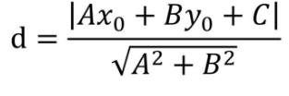
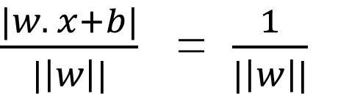
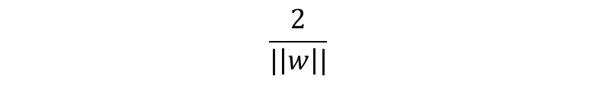
Maximizing the margin
We want a classifier with as big margin as possible.
Recall the distance from a point(x₀,y₀) to a line:Ax+By+c = 0 is
The distance between H and H1 is:
The distance between H1 and H2 is:
In order to maximize the margin, we need to minimize ||w||.
With the condition that there are no datapoints between H1 and H2:
x_{i}•w+b = +1 when y_{i} =+1
x_{i}•w+b = -1 when y_{i} =-1 Can be combined into y_{i}(x_{i}•w) = 1

Slide 20
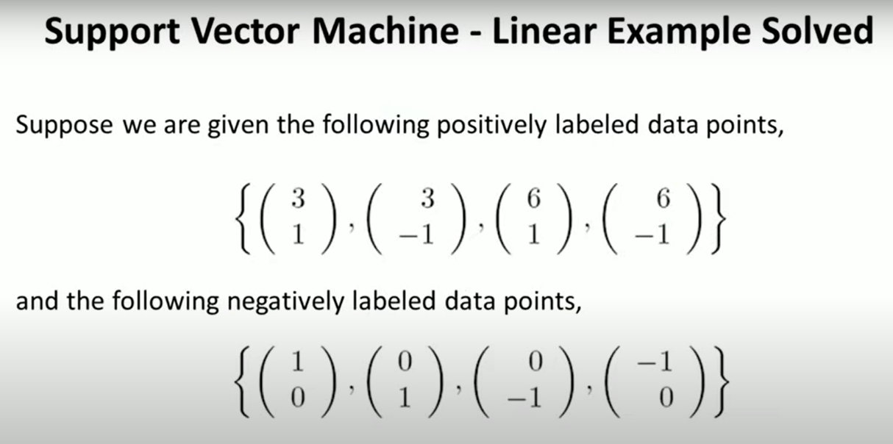

Slide 21
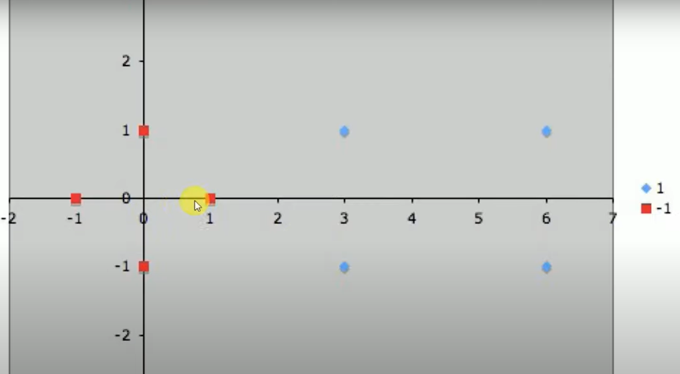

Slide 22
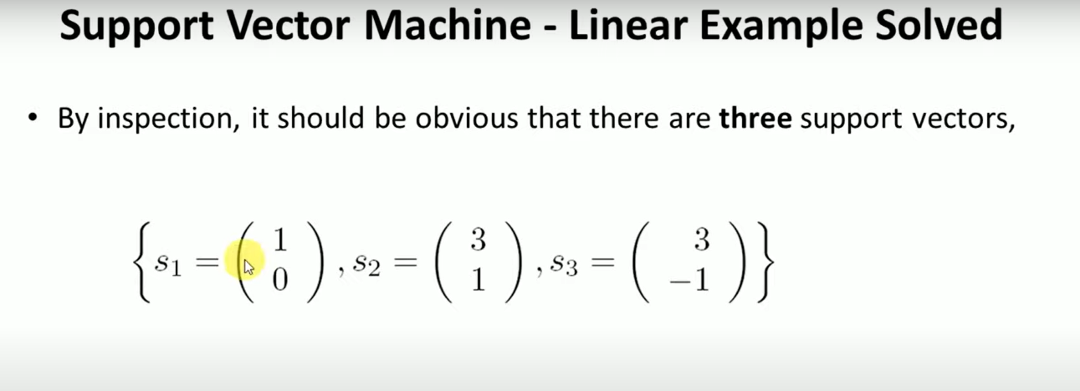

Slide 23
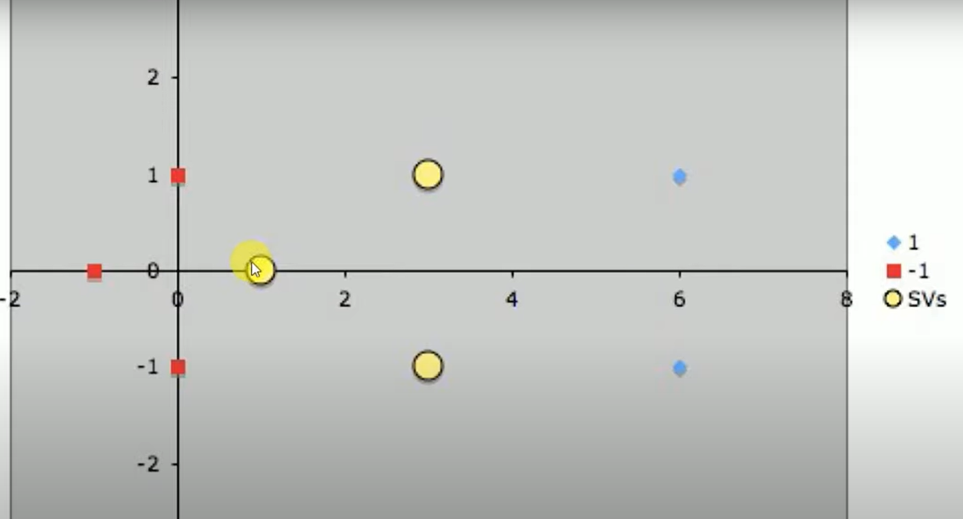

Slide 24
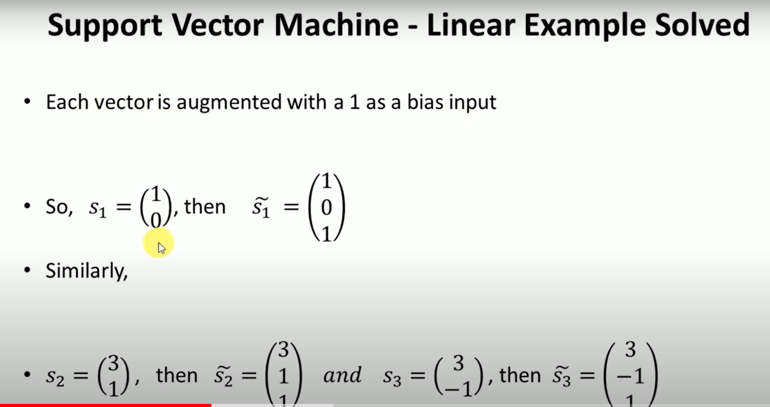

Slide 25
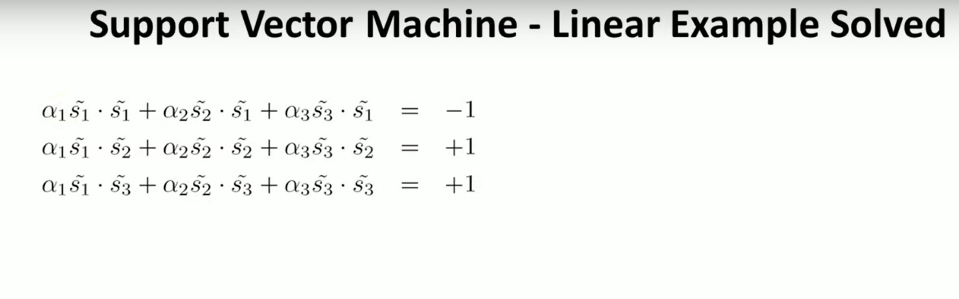

Slide 26
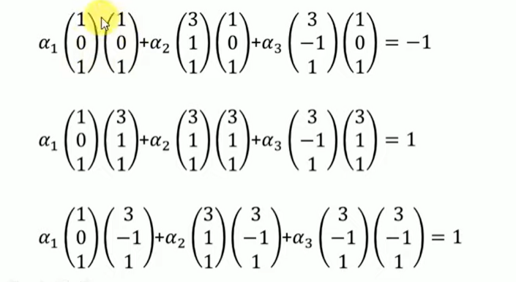

Slide 27
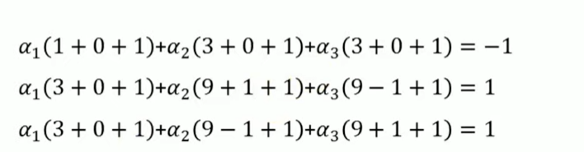

Slide 28
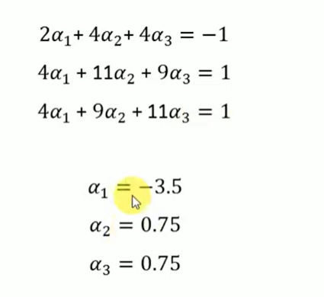

Slide 29
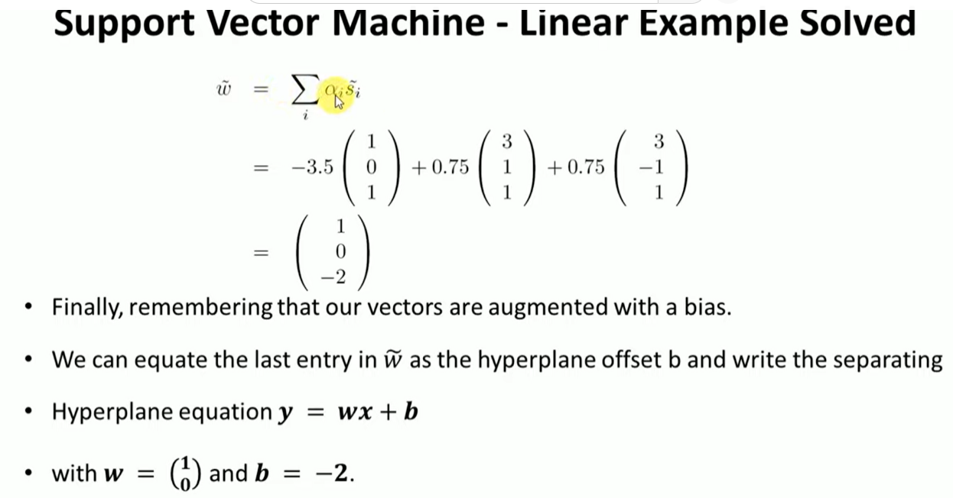

Slide 30
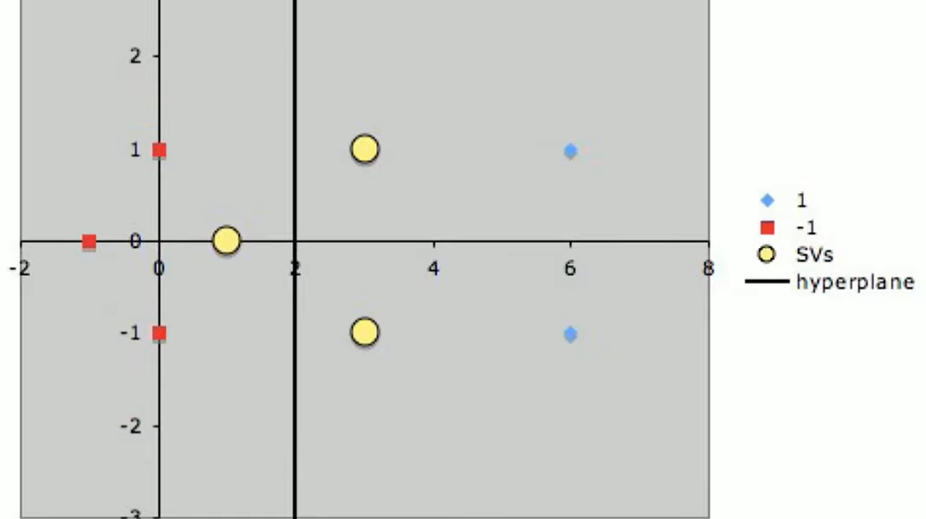

Slide 31
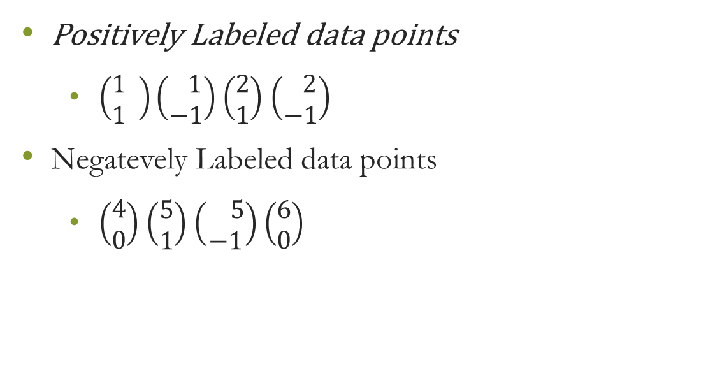

Slide 32
Popular SVM Kernel functions:
Linear Kernel: It is just the dot product of all the features. It doesn’t transform the data.
Polynomial Kernel: It is a simple non-linear transformation of data with a polynomial degree added.
Gaussian Kernel: It is the most used SVM Kernel usually used for non-linear data.
Sigmoid Kernel: It is similar to the Neural Network with sigmoid activation function.

Slide 33
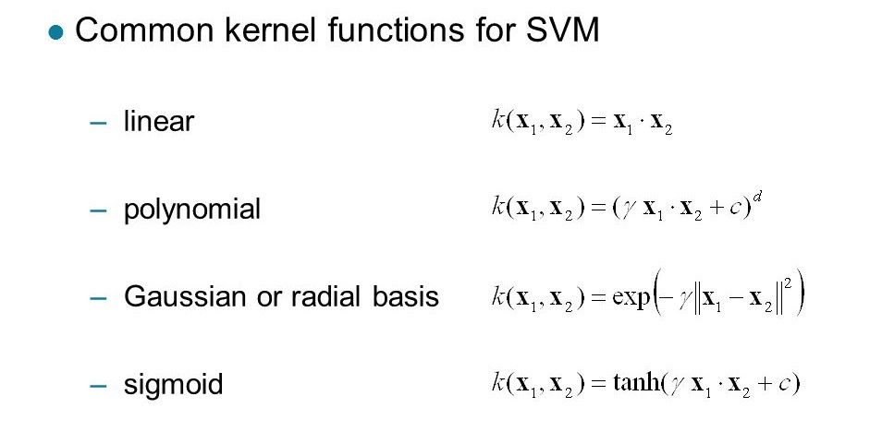

Slide 34
Pros and Cons associated with SVM
Pros:
It works really well with a clear margin of separation
It is effective in high dimensional spaces.
It is effective in cases where the number of dimensions is greater than the number of samples.
It uses a subset of training points in the decision function (called support vectors), so it is also memory efficient.

Slide 35
Cons:
It doesn’t perform well when we have large data set because the required training time is higher
It also doesn’t perform very well, when the data set has more noise i.e. target classes are overlapping
SVM doesn’t directly provide probability estimates, these are calculated using an expensive five-fold cross-validation. It is included in the related SVC method of Python scikit-learn library.

Slide 36
Problems that can be solved using SVM
Image classification
Recognizing handwriting
Cancer detection

Slide 37
Difference between SVM and Logistic Regression
SVM tries to finds the “best” margin (distance between the line and the support vectors) that separates the classes and this reduces the risk of error on the data, while logistic regression does not, instead it can have different decision boundaries with different weights that are near the optimal point.

Slide 38
SVM works well with unstructured and semi-structured data like text and images while logistic regression works with already identified independent variables.
SVM is based on geometrical properties of the data while logistic regression is based on statistical approaches.
The risk of overfitting is less in SVM, while Logistic regression is vulnerable to overfitting.

Slide 39
When To Use Logistic Regression vs Support Vector Machine
Depending on the number of training sets (data)/features that you have, you can choose to use either logistic regression or support vector machine.
Lets take these as an example where : n = number of features, m = number of training examples

Slide 40
1. If n is large (1–10,000) and m is small (10–1000) : use logistic regression or SVM with a linear kernel.
2. If n is small (1–10 00) and m is intermediate (10–10,000) : use SVM with (Gaussian, polynomial etc) kernel
3. If n is small (1–10 00), m is large (50,000–1,000,000+): first, manually add more features and then use logistic regression or SVM with a linear kernel

